Slide 1
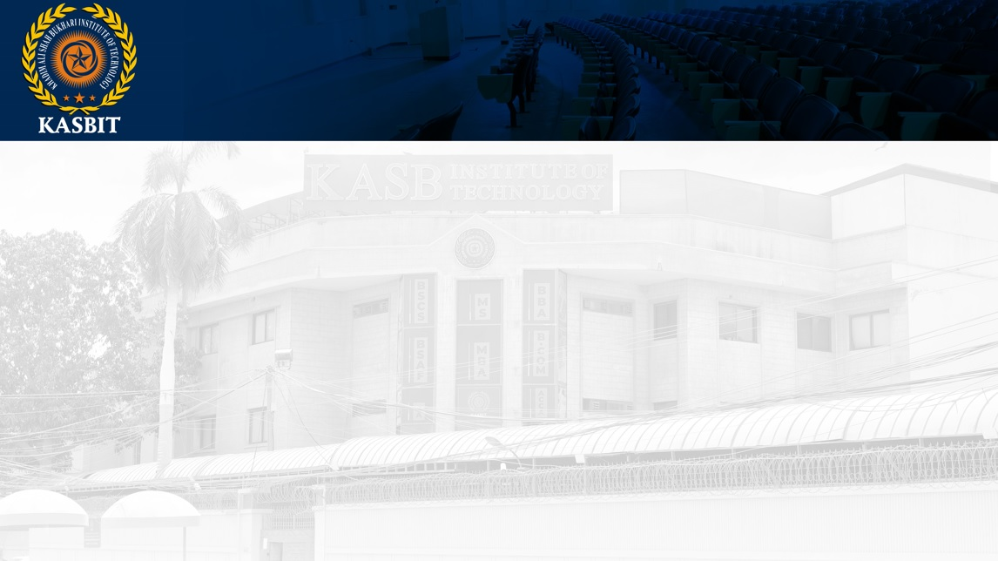
Fundamentals of Management
SESSION 1
BY
Azar Ejaz Ateeq

Slide 2
Chapter 1
Managers and You in the Workplace

Slide 3
Introduction
Manager
A manager is someone who coordinates and oversees the work of other people so organizational goals can be accomplished.
Operatives/ Non Managerial Employees
People who work directly on a job or task and have no responsibility for overseeing the work of others
First-line (Frontline) Managers
Managers at the lowest level of management who manage the work of non managerial employees. These managers often have titles such as supervisors or even shift managers, district managers, department managers, or office managers.
Reference: Management, 14th Edition by Stephen P. Robbins

Slide 4
Middle Managers
Middle managers manage the work of first-line managers and can be found between the lowest and top levels of the organization. They may have titles such as regional manager, project leader, store manager, or division manager. Middle managers are mainly responsible for turning company strategy into action.
Top Managers
Managers at or near the upper levels of the organization structure who are responsible for making organization-wide decisions and establishing the goals and plans that affect the entire organization. These individuals typically have titles such as executive vice president, president, managing director, chief operating officer, or chief executive officer.
Reference: Management, 14th Edition by Stephen P. Robbins

Slide 5
Functions of Top Level Management
Determining Objectives
Determining Policies
Determining Activities
Assembling Resources
Controlling the Work Performance
Approving Budgets
Reference: Management, 14th Edition by Stephen P. Robbins

Slide 6
Functions of Middle Level Management
Interpreting Policies
Preparing Organizational set-up
Appointing Employees
Issuing Instructions
Motivating Employees
Creating Cooperation
Collecting & Submitting Information
Submitting Suggestions
Reference: Management, 14th Edition by Stephen P. Robbins

Slide 7
Functions of Lower Level Management
Submitting Workers Grievances
Ensuring Proper working Environment
Ensuring Safety of Workers
Helping Middle Level Management
Inviting Suggestions
Creating better Human Relations
Reference: Management, 14th Edition by Stephen P. Robbins

Slide 8
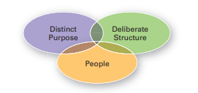
Organization
A deliberate arrangement of people to accomplish some specific purpose. All are considered organizations and have three common characteristics.
Reference: Management, 14th Edition by Stephen P. Robbins

Slide 9
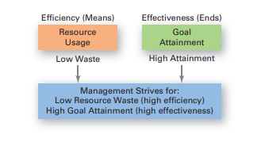
Management
Management involves coordinating and overseeing the work activities of others so their activities are completed efficiently and effectively.
Efficiency
Doing things right, or getting the most output from the least amount of inputs
Effectiveness
Doing the right things, or doing those work activities that will result in achieving goals
Reference: Management, 14th Edition by Stephen P. Robbins

Slide 10
Management Functions
Planning
Management function that involves setting goals, establishing strategies for achieving those goals, and developing plans to integrate and coordinate activities
Organizing
Management function that involves arranging and structuring work to accomplish the organization’s goals
Reference: Management, 14th Edition by Stephen P. Robbins,

Slide 11
Leading
Management function that involves working with and through people to accomplish organizational goals
Controlling
Management function that involves monitor work performance ing, comparing, and correcting
Reference: Management, 14th Edition by Stephen P. Robbins

Slide 12
THANK YOU

